Slide 1
Using AI to Solve: Community Detection
Genetic Algorithms and Particle Swarm Optimization

Slide 2
Outline
What is AI?
What are Genetic Algorithms?
What is Particle Swarm Optimization?
What is Community Detection?
The Genetic Algorithm Approach
The PSO Approach
Our Report Idea

Slide 3
What is Artificial Intelligence?
A subfield of computer science that attempts to have programs solve problems
Replicates behaviors in Nature
Examples:
Genetic Algorithms
Particle Swarm Optimization

Slide 4
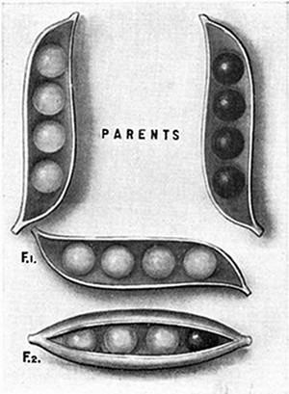
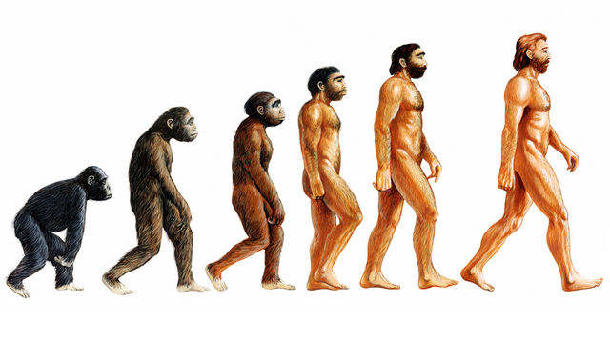
Genetic Algorithms
Based on Darwin’s Theory of Evolution and Mendel’s Theory of Inheritance
Solves problems over multiple generations
Represents the solutions as Genes
The Genes are selected and then crossed over to create a new generation
Continues for a specified generation count
Solutions converge to better solutions over the generations

Slide 5

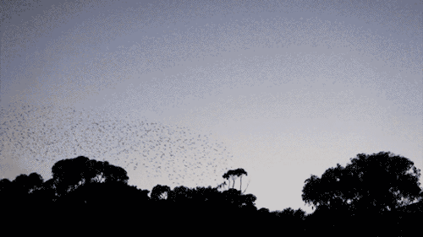
Particle Swarm Optimization
Based on the Flocking patterns of birds

Slide 6
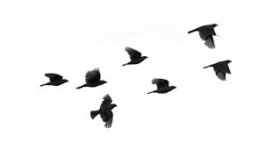
Follow The Leader
Leader
Direction
Position

Slide 7
Global Best
1
Global Best
Particle
Actual Best
Personal
Best
Solutions

Slide 8
Update Direction and Position
Inertia component (ω) – influence of the previous computed velocity Random, stochastic component
Cognitive component (c1) – influence of the personal best position found (pbest )
Social component (c2) – influence of the swarm collective via the global best position found (gbest)
(r1,r2) – uniform random vectors with component values between 0 and 1

Slide 9
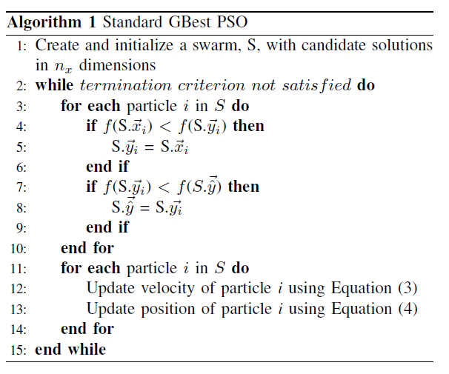
Algorithm

Slide 10
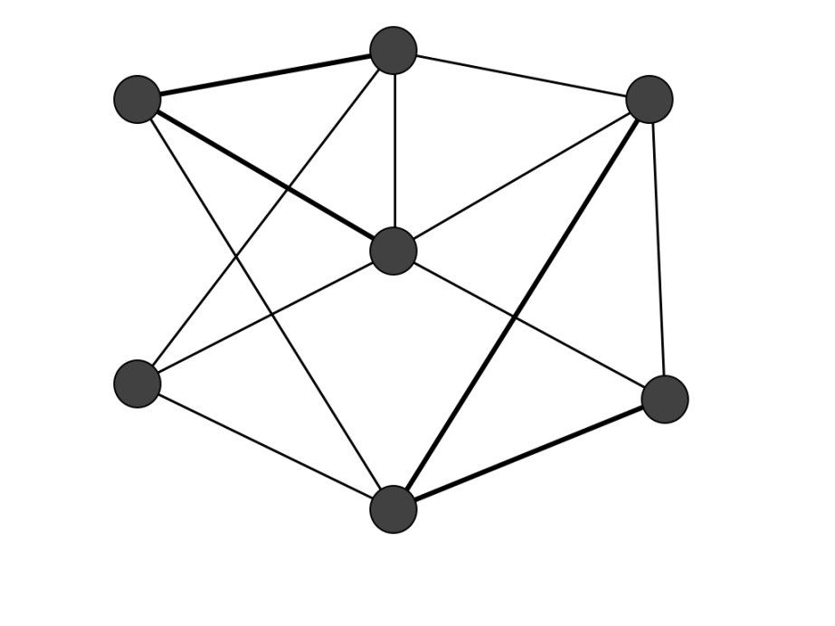
Community Detection
A Study of networks
Network = (V,E)
Or a set of nodes (V) that are connected by edges
People
Computers
Network Connections
Friendships

Slide 11
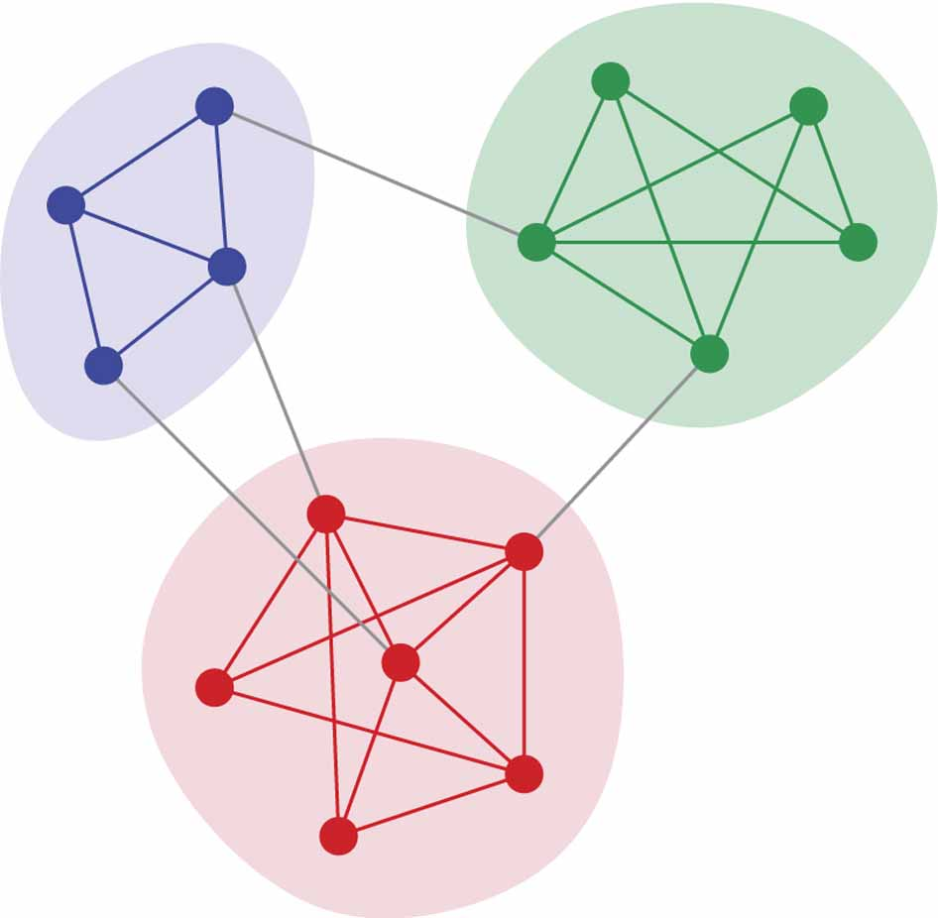
Community
B
A
A subset of the network
Has many internal edges (i.e. connections to nodes in the community)
Has few external edges (i.e. connections to nodes outside the community)
Can be hard to find since we do not know the number of communities before hand
C

Slide 12
How to solve with GA?
We looked at 2 approaches
One using a standard genetic algorithm
Other using Multi-objective Genetic Algorithm

Slide 13
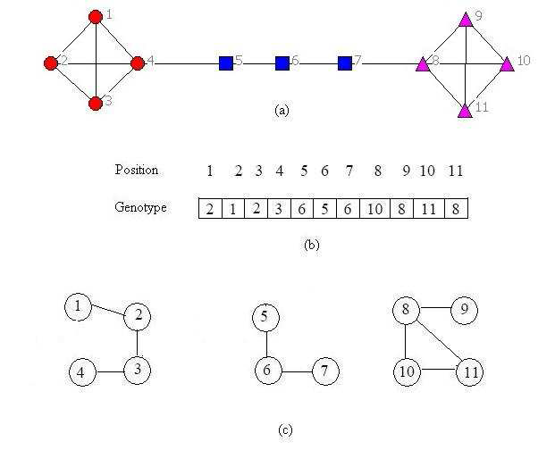
Representation
Networks defined in adjacency matrix
Genes
A community matrix
the value of 2 in position 1 denotes that node 1 is in the same community as node 2
Ensures ‘safe’ genes by ensuring connections noted in the genes exist in the original adjacency matrix

Slide 14
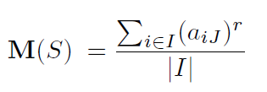
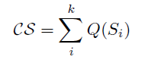
Genetic Solution
Fitness
Uses the community score
Calculates the density of 1s in the subset of the adjacency matrix
Calculates the power mean for each community and summates the results

Slide 15
Genetic Properties (ctd)
Crossover
Uniform Order to ensure valid children
Mutation
Randomizes genes to available ‘safe’ genes
Selection
Roulette Selection
Elitism
10%
Initialization
Randomly generate ‘safe’ examples

Slide 16
Multi-Objective Version
Splits the problem into multiple objectives
Objective 1: Maximize internal connections
Objective 2: Minimize external connections
Similar to previous but:
uses fitness function
K^{in} / (K^{in +} K^{out})
Non-dominated Sorting GA
Non dominated solutions are kept (like elite)

Slide 17
Non-Dominated Sorting GA
Sorts the solutions by non-dominated
Keeps the non-dominated solutions between generations
Like elite
Returns multiple non-dominated solutions
Searches for the Pareto Front

Slide 18
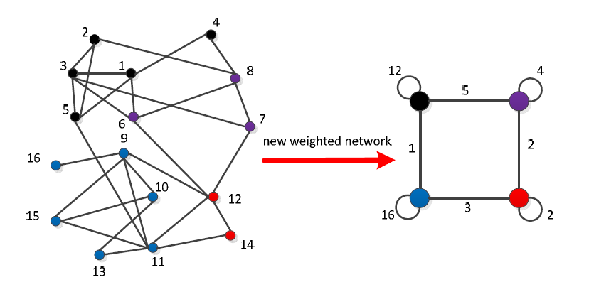
PSO Implementation
First performs a clustering algorithm

Slide 19
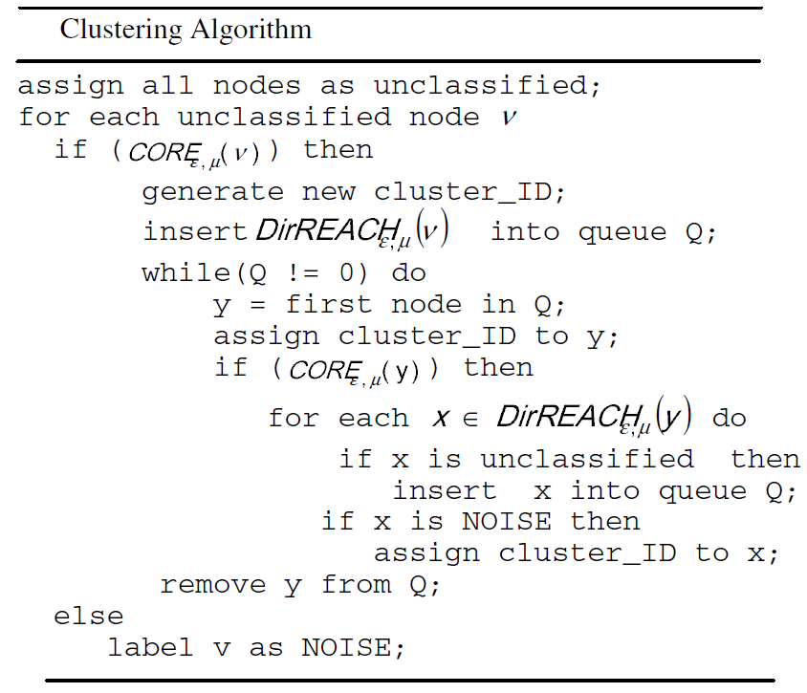
PSO Solution
Performs one clustering pass
Finds core nodes (nodes the have a preset threshold of connections)
Nodes directly connected to core nodes are part of the core node cluster
Then combine clusters into a single node

Slide 20
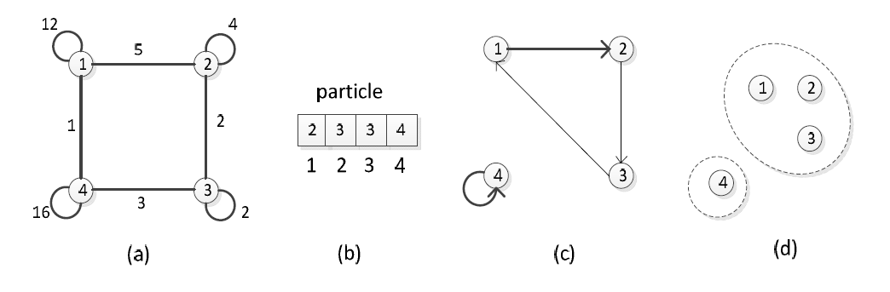
Particles
Represented similar to GA

Slide 21
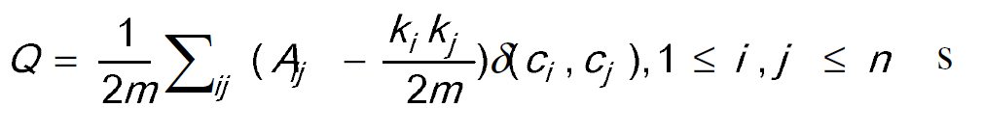
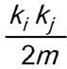
Particle Fitness
Uses the modularity function to calculate fitness
Calculates the number of internal nodes vs the potential number of internal nodes
A_{ij} = 1 or 0 if there is a connection between nodes
= the expected number of edges between
Determines if there are more internal connections in the network

Slide 22
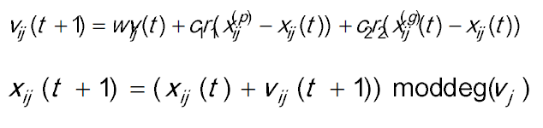
Vector and Position Update
Adjust the velocity of each index of the particle based on the local best, global best and current velocity
Uses mod to ensure it doesn’t surpass the number of nodes

Slide 23
Report Idea
Compare Genetic Algorithms and PSO
Determine which is best for the problem of Community Detection

